Slide 1
The aging physician population: Neuropsychological perspectives
William Perry, Ph.D.
Professor of Psychiatry
University of California, San Diego

Slide 2
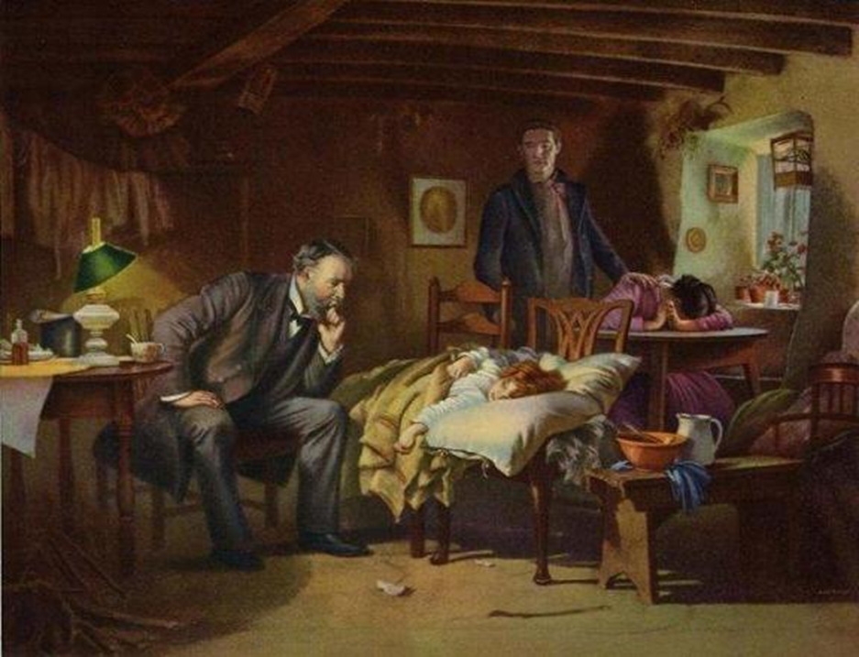
Conventional wisdom about physician expertise generally holds that the longer a physician has been in practice, the better honed his or her clinical skills become

Slide 3
The aging physician population
Hobus et al. (1987) presented physicians with short case histories consisting of a patient's picture, previous disease history, and presenting complaint.
A strong positive correlation between experience and diagnostic accuracy (r = .68).
Their initial hypotheses however was correct only 38% of the time and they used contextual information drawing from experience.

Slide 4
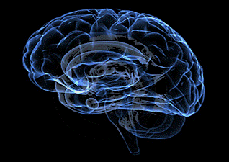
The aging physician population: Ageism?

Slide 5
What are the concerns?
Hartz and colleagues (1999) examined operative mortality among 275 surgeons performing coronary artery bypass grafting. They found that mortality rates increased with years of experience.
Older physicians are less likely to incorporate new treatment strategies into their practice and less likely to prescribe appropriate medications.
Stolley, Becker, Lasagna, et al. Med Care. 1972;10:17–28
Rhee.Med Care. 1976;14:733–750

Slide 6
What are the concerns ?
Older physicians have poorer performance on recertification examinations and are less likely to have a current knowledge base.
Ramsey PG, Carline JD, Inui TS, et al. JAMA. 1991;266:1103–1107

Slide 7
Systematic Review: The Relationship between Clinical Experience and Quality of Health Care
Choudry, Fletcher & Soumerai Ann Intern Med. 2005;142:260-273
Of 62 published studies that measured physician knowledge or quality of care and described time since medical school graduation or age, more than half suggested that physician performance declined over time for all outcomes measured.
Only 1 study showed improved performance
for all outcomes measured.

Slide 8

Why assess Neuropsychological/ cognitive abilities?

Slide 9
Physicians are among those special groups who operate in an environment unforgiving of human error, where cognitive failure can lead to catastrophic consequences.

Slide 10
Why assess cognitive abilities?
Turnbull PREP Program in Canada assessed “impaired” physicians before and after remediation and found that failure to remediate was associated with cognitive problems.
Turnbull study demonstrates that neuropsychological testing can identify physicians who are less likely to improve with remediation.

Slide 11
Percentage of PACE physicians that scored 1 SD below the mean (Perry & Crean, 2005)
Test | % mean
WAIS –R Picture Arrangement | 25
CVLT list learning trials 1-5 | 25
Category Test errors | 30
Trail Making Test-Part A | 29
Numerical Attention Test | 42
Symbol-digit modality | 22
Complex figure learning | 30

Slide 12
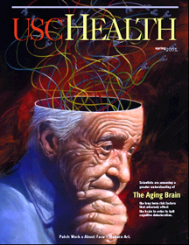
Does age effect competence?

Slide 13
The Aging Brain
Facts of aging:
Cardiovascular changes (hypertension)
Renal changes (strong relationship BMI, diabetes and Memory)
Pulmonary changes
Urogenital changes
Decreased visual acuity
Decreased physical strength and stamina
Often decreased hearing
Notes:
Marjorie

Slide 14
The Aging Brain
Facts of aging on cognition:
Decreased reaction time
Decreased fine motor skills/ dexterity
Difficulty learning new concepts and skills
Decreased comprehension of complex information
Decreased analytic processing
Decrease attention to novel details
Notes:
Marjorie

Slide 15
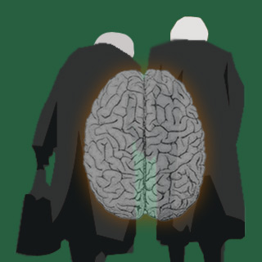
Understanding the cognition-performance link in older physicians

Slide 16
Crystalized vs. Fluid Knowledge
Crystalized knowledge involves accumulated knowledge and expertise and relies on long term memory…habitual procedures.
Fluid knowledge involves novel problem solving, spatial manipulation, mental speed, and identifying complex relations among stimulus patterns.

Slide 17
Crystalized Abilities
Crystalized abilities increase during the lifespan through education, occupational and cultural experience and exposure to culture and
intellectual pursuits.
Crystalized abilities are less affected by aging and disease and often remain intact in the early stages of dementia or after brain injury.

Slide 18
Fluid Abilities
The developmental trajectory of fluid abilities follow neurological maturation, peaking in the mid 20s and declining gradually until the 60s when a more steep decline takes place.
Fluid abilities are affected by neurological insult, genetics and biological aging processes.

Slide 19
The Aging Physician and Changes in Cognitive Processing and Their Impact on Medical Practice
Eva & Barnes (2002) Acad Med,77:S1-S
Analytic processing tend to decline with age whereas nonanalytic processing remains stable.
Older physicians tend to do less well when dealing with novel, conflicting, and complex patient situations.
The more individuals rely on their prior experience, the less of a tendency there will be to critically assess novel conflicting information.

Slide 20
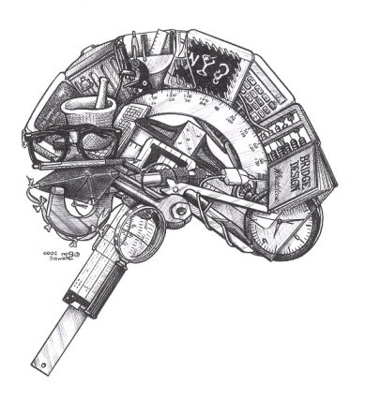
The role of neuropsychology in assessing the aging physician

Slide 21
Goals of a Neuropsychological (diagnostic) /Fitness for Duty Evaluation
To screen for covert disease and diagnose a neuropsychological/neurological condition (Dementia, Mild Cognitive Impairment, Significant Attentional Disorder).
To determine if a primary health condition (cardiovascular /pulmonary/ hepatic and renal changes) is impacting his/her cognitive functioning.
To address disease issues we rely on age-related comparisons.

Slide 22
Goals of a Neuropsychological/Fitness for Duty Evaluation
To assess the physical, cognitive and emotional capacity to independently perform essential functions competently and in a manner that does not threaten the safety and health of patients.
Link cognitive abilities to function.
To address functionality we rely less on age and more on minimum standard of acceptable functioning.
Self and other report is often not useful.

Slide 23
Fitness for Duty Evaluation: The Federation of State Medical Boards Committee on Evaluation of Quality of Care and Maintenance of Competence
Identify dyscompetence as a “failure to maintain acceptable standards in one or more areas of professional practice.”
Performance demands differ depending upon whether the physician engages in surgery (skill-based) or primary care (knowledge-based).
Specialty Board exams test knowledge not performance.

Slide 24
Things to consider: Accurate assessment of older physicians’ competence may be hampered by several factors
Older physicians may have a lower case load and therefore less opportunity for peer review.
Younger physicians may feel uncomfortable voicing concerns about older colleagues out of respect, or because the older physician may have been their mentor.
Detecting subtle cognitive impairment of an older physician is often difficult given their above-average premorbid functioning. Furthermore cut-offs used to determine dementia are too low resulting in increased false-negatives.

Slide 25
Things to consider: Accurate assessment of older physicians’ competence may be hampered by several factors (cont)
Physicians in solo practice or in rural communities may escape scrutiny by peers.
Hospitals may be more lenient because of difficulty replacing physician staff .
Hospitals may be reluctant to attend to warning signs because of revenue the physician generates.

Slide 26
What Neuropsychological Assessment Battery to use.
Computerized Batteries (heavily weighted on
attention and reaction time)
  Microcog, Cogscreen, CANTAB
  Comprehensive assessment of cognition (paper and pencil and computerized tests)
  Physician Review Program (PREP) assessment: WAIS, WMS, CVLT, Trail Making Test, WCST, Verbal Fluency tests, Stroop,
  PASAT, Rey-O

Slide 27
Neuropsychological Domains and its Relationship to Medical Practice
Medical Practice
Neuropsychological Function
Premorbid intelligence and reading skills
Indication of a decline in function over time.
The ability to profit from continuing education.
The ability to understand and communicate in English

Slide 28
Neuropsychological Domains and its Relationship to Medical Practice
Medical Practice
Neuropsychological Function
The ability to attend and determine what is critical and salient.
To sustain auditory and visual attention over a sustained period of time.
The ability to inhibit impulsive and incorrect responses
Attention

Slide 29
Neuropsychological Domains and its Relationship to Medical Practice
Medical Practice
Neuropsychological Function
Learning and
Memory
The ability to learn and integrate new information as well as draw from past experience.
The ability to recognize and recall information efficiently and quickly, without irrelevant information impeding.

Slide 30
Neuropsychological Domains and its Relationship to Medical Practice
Neuropsychological Function
Medical Practice
Perceptual-motor
skills
The ability to perform physical tasks.
Eye-hand coordination.
The ability to manipulate instruments with accuracy.

Slide 31
Neuropsychological Domains and its Relationship to Medical Practice
Medical Practice
Neuropsychological Function
Recognize the significance of unexpected situations in order to quickly make alternative plans when unusual events arise.
Planning or decision making abilities.
Error correction or troubleshooting.
Executive Function Skills

Slide 32
Summary:
Reviewed literature that suggests that aging induces cognitive changes and that these changes impact physician practice.
We linked cognition to performance :Older physicians draw from prior instances and rely more heavily on nonanalytic processes in their clinical practice.

Slide 33
Summary: continued
The role of neuropsychology in assessing the aging physician.
Explained the difference between a neuropsychodiagnostic assessment and a Fitness for Duty evaluation.

Slide 34
Next Step: remediation of deficiencies in medical practice
“Doctors can accommodate cognitive decline by choosing to cease procedural work, allocating more time to each patient, using memory aids, seeking advice from trusted colleagues, and seeking second opinions.”
  Adler RG, Constantinou C. (2008). Knowing - or not knowing - when to stop: cognitive decline in ageing doctors. Med J Aust. 1-15;189(11-12):622-4
  With growing research we can begin to identify
  specific strategies for the continuing education
  of older physicians.

Slide 35

Thank you

